Slide 1



United College Of Engineering & Research
Crime Glance
Submitted for partial fulfillment of
B.Tech In
Information Technology
Group Members
Dixa Rai(1900100130033)
Kirti Jha(1900100130048)
Km. Jyoti Sharma(1900100130050)
Guided By:
Mr. Bhanu Pratap Rai
Assistant Professor
CSE/IT
UCER

Slide 2

Presentation Flow
Introduction
Objectives
Tools & Technology
Flow Chart
Project Snippets
Prediction Algorithms
Prediction System
Model Comparisons
Diagrams
Conclusion
Future Scope
References

Slide 3
Introduction
Crime Glance is a web based application based on machine learning techniques where one can easily get the information related to the crimes happening in a particular place.
It provides users with the features to check the safety measure of a place, i.e., safe, moderately safe or unsafe , get the details of a city, know the distribution of crime that happened in a city over the years and also provides the facility of helpline where users can easily get the helpline contacts of police officials and direct link to state government website where they can easily file an e-FIR and get the related information.
It can help reduce criminal events by foreseeing and preventing crimes, improving the safety and well-being of people and communities.

Slide 4
Objectives
Create a web based application using machine learning techniques that will help people know about the crimes in their city.
To help people know the safety measures of their city, i.e., their city falls in the category of safe, unsafe or moderately safe.
To assist people with helpline facility and links to file e-FIR.
To provide people with the crime distribution over the years.
The website will offer insightful information to people, law enforcement organizations, and decision makers to successfully prevent and handle criminal activity.

Slide 5
Tools and Technologies
Frontend design : HTML, CSS, Bootstrap 5, React Js
Backend : Django, NodeJs
Database : MongoDb
Machine Learning IDE : Jupyter Notebook

Slide 6
Flowchart
Login / Sign up
User
Admin
Home
About Us
Crime Info
Contact Us
Update Record
Login / Sign up
Home
About Us
Crime Info
Contact Us
Login / Sign up
Home
About Us
Crime Info
Contact Us
Login / Sign up

Slide 7
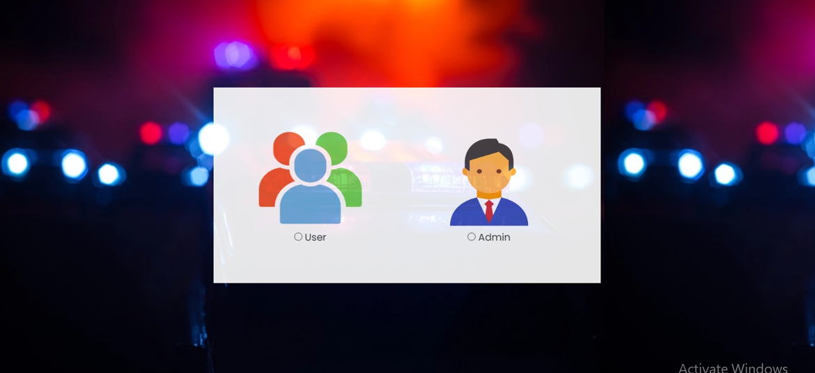
Front Page

Slide 8
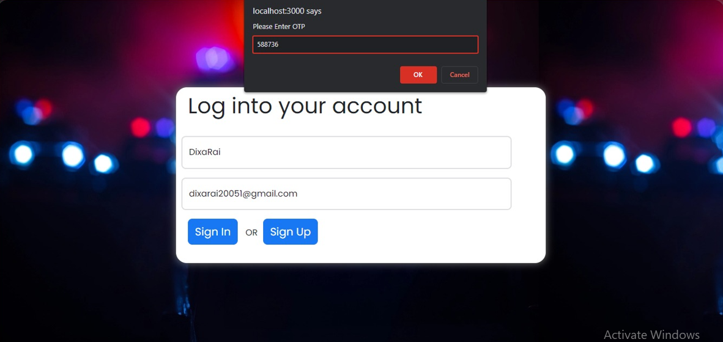
User Login Page

Slide 9
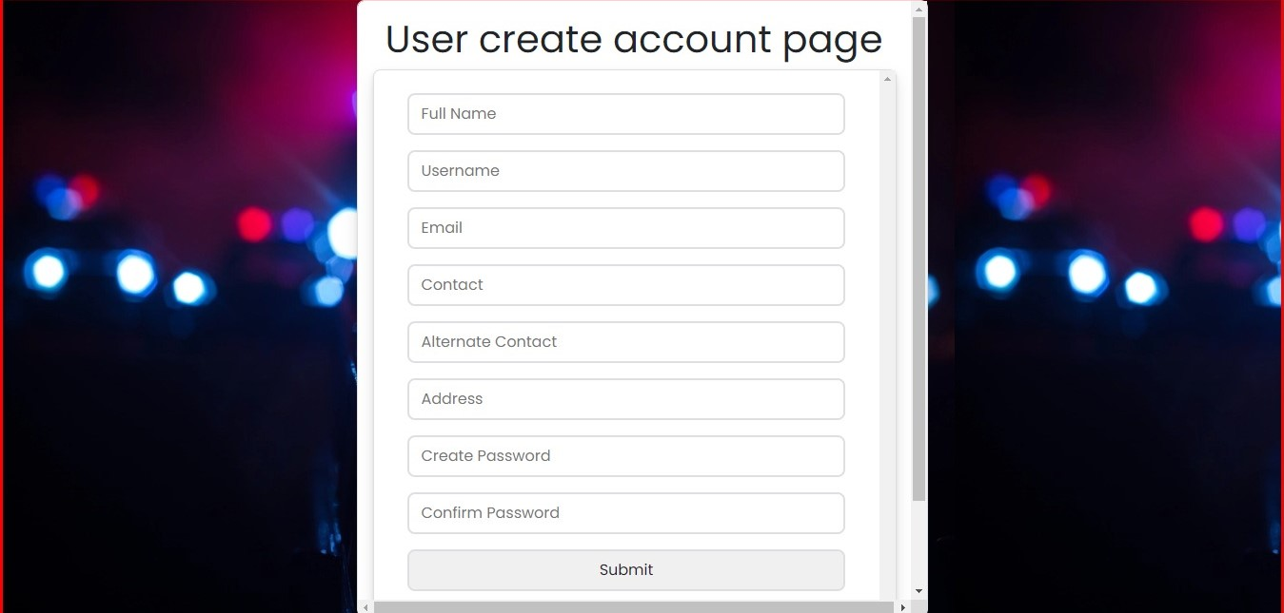
User Create Account Page

Slide 10
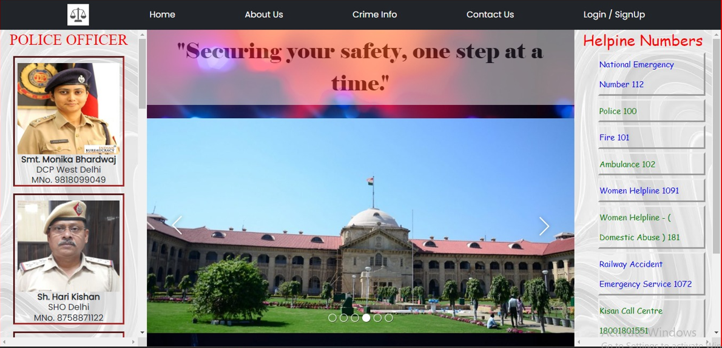
User Front Page

Slide 11
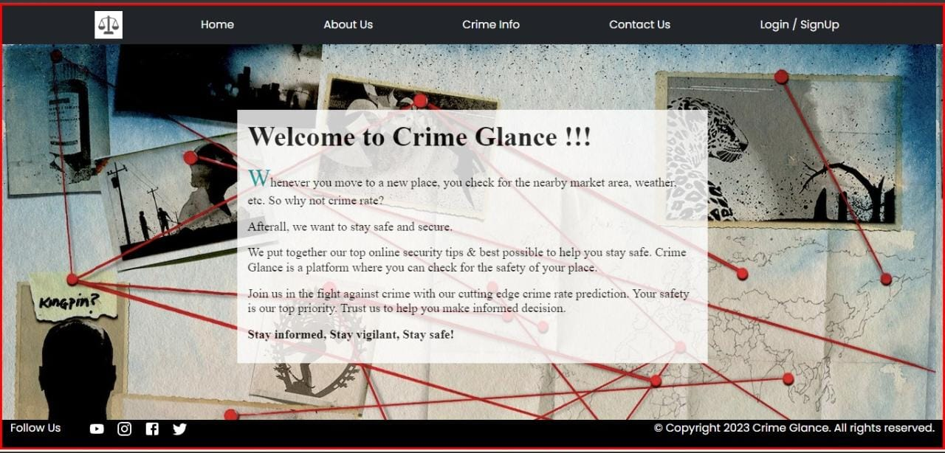
About Us

Slide 12
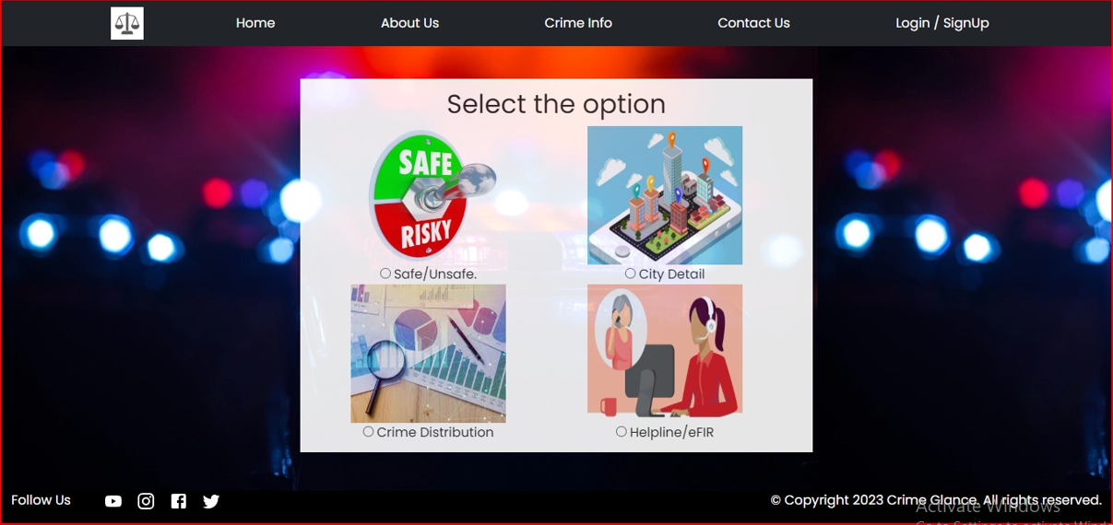
Crime Info

Slide 13
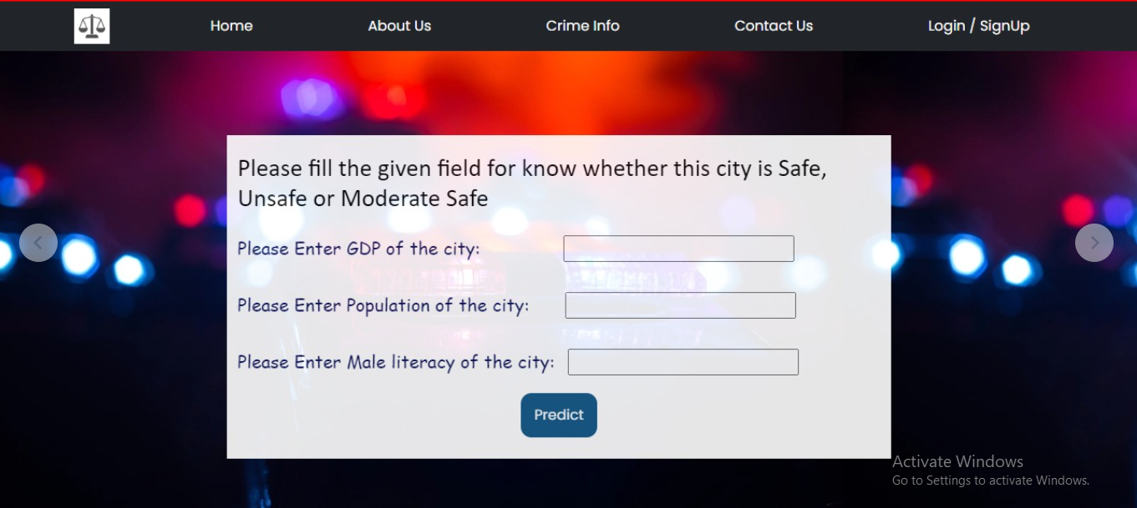
Safe / Unsafe

Slide 14
Prediction Algorithms
Linear Regression
Support Vector Machine
Decision Tree
Random Forest
K- Nearest Neighbours

Slide 15
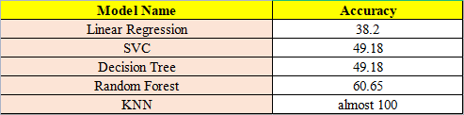
Model Comparisons
We get maximum accuracy using KNN algorithm, so we are proceeding with it in our system.

Slide 16
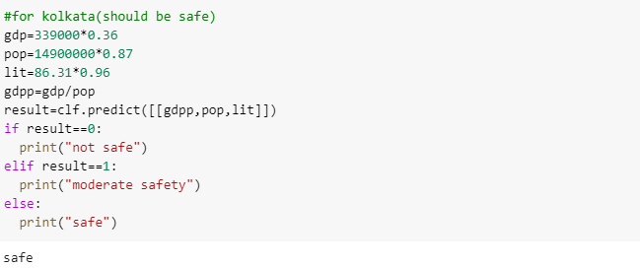
Prediction System - Safety Measures

Slide 17
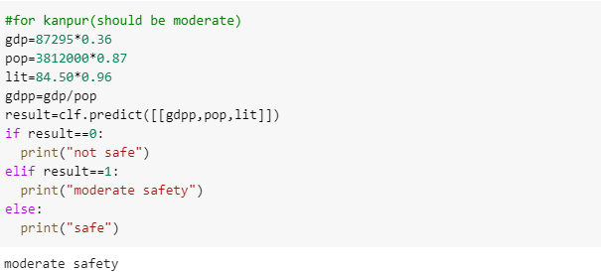
Prediction System - Safety Measures

Slide 18
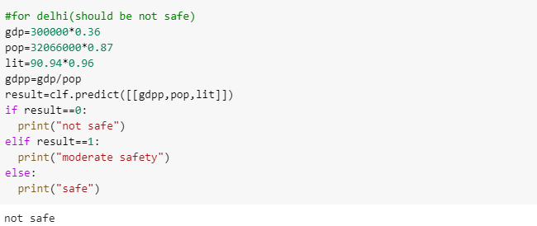
Prediction System - Safety Measures

Slide 19
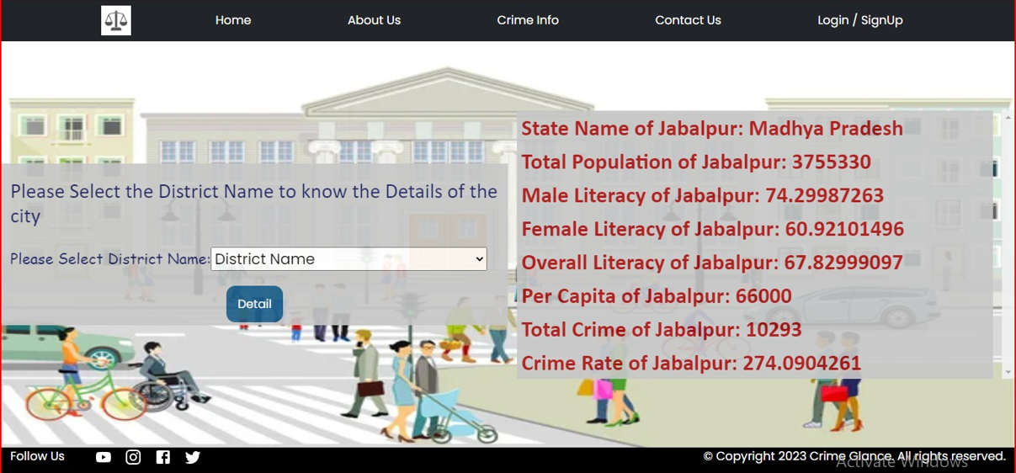
City Details

Slide 20
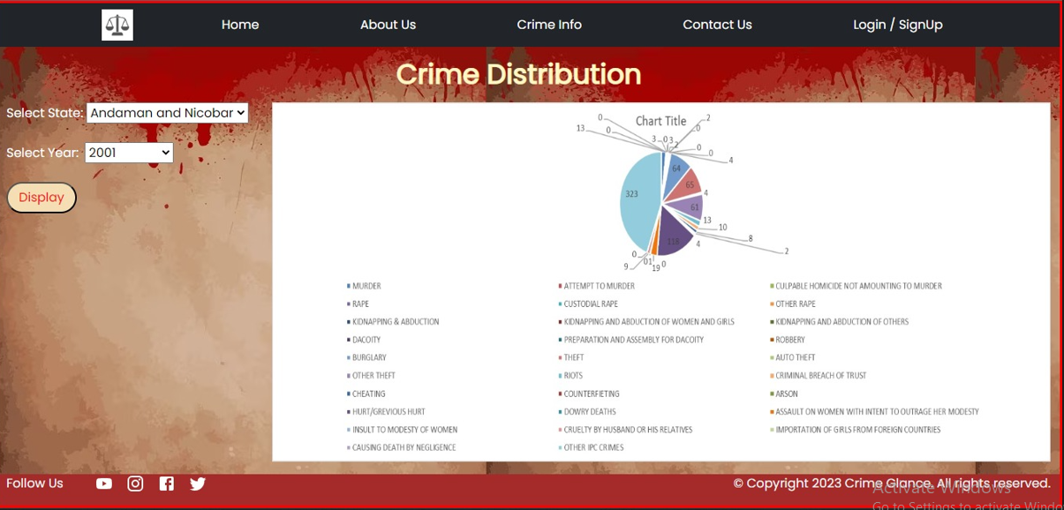
Crime Distribution

Slide 21
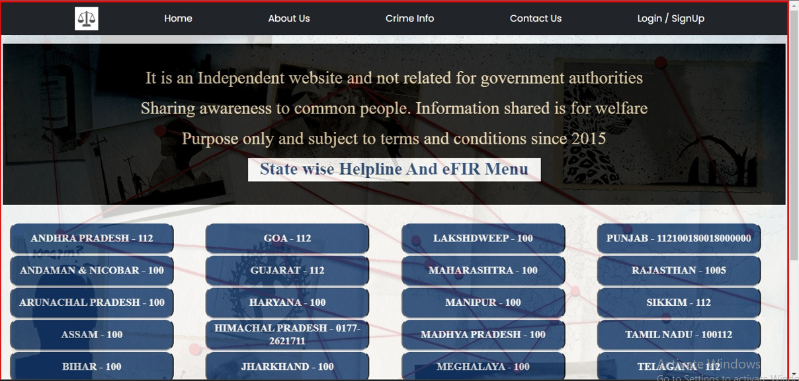
Helpline and eFIR Menu

Slide 22
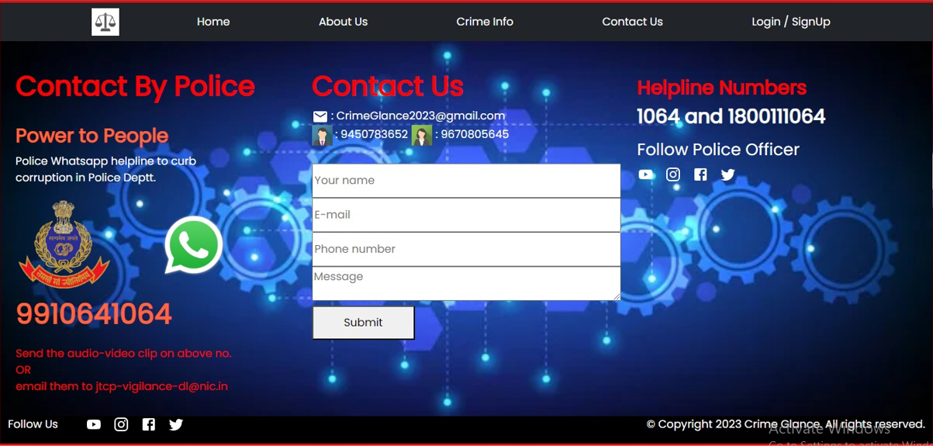
Contact Page

Slide 23
Admin Login Page

Slide 24
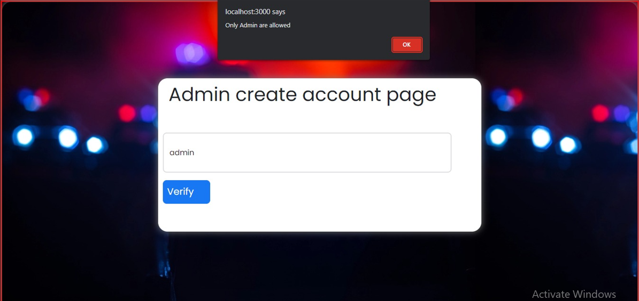
Admin Page

Slide 25
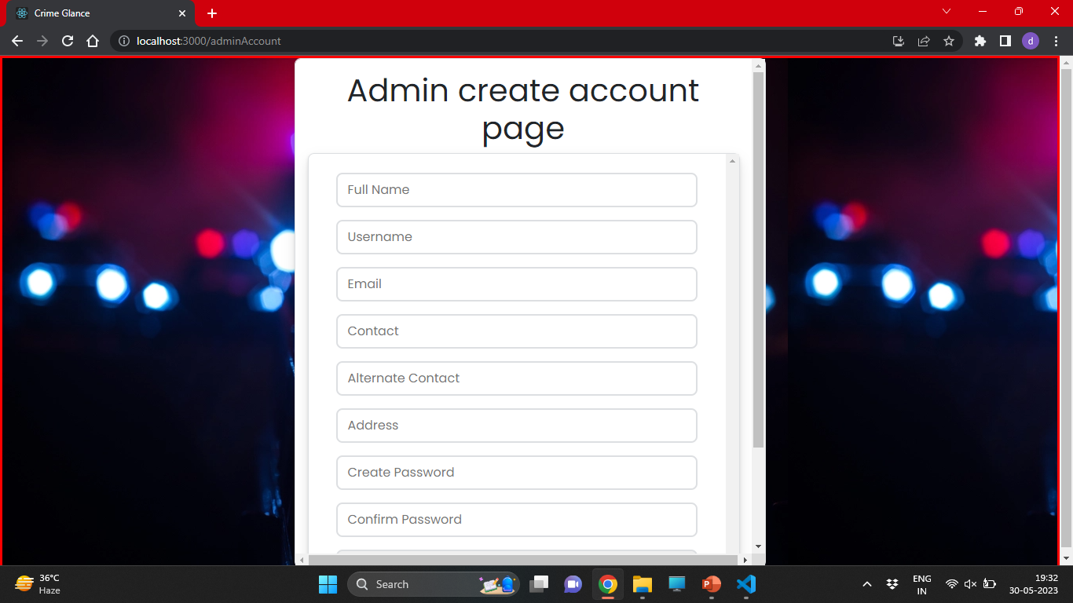
Admin Create Account Page

Slide 26
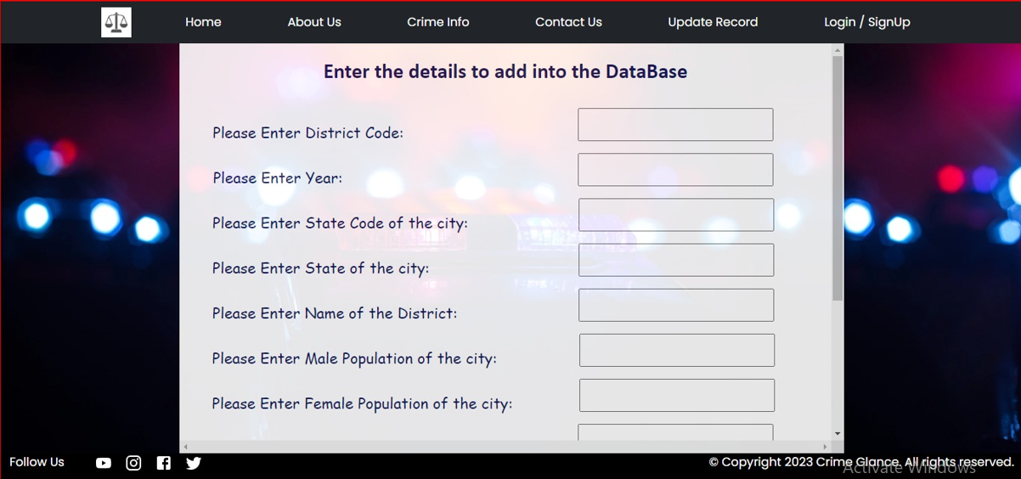
Update Records

Slide 27
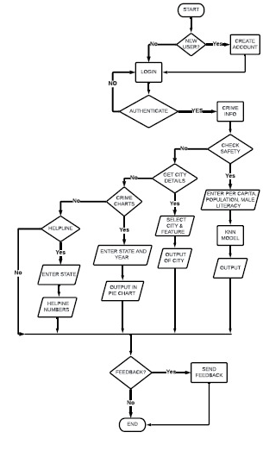
Flowchart

Slide 28
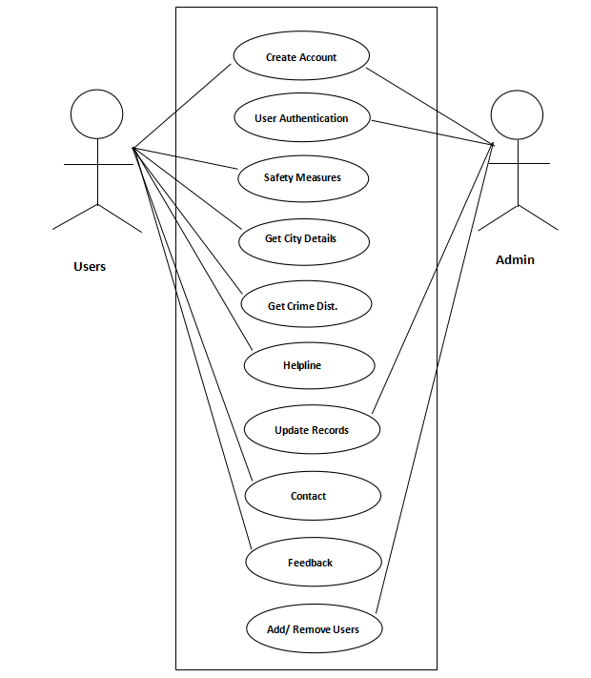
Use Case Diagram

Slide 29
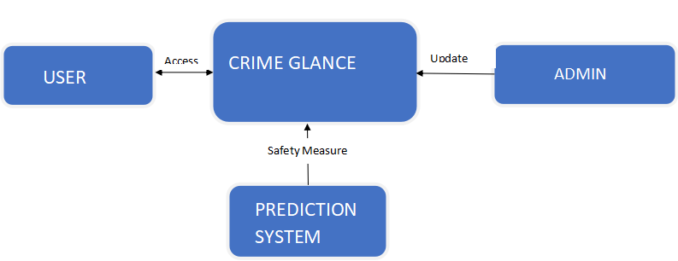
Data Flow Diagram - 0 Level

Slide 30
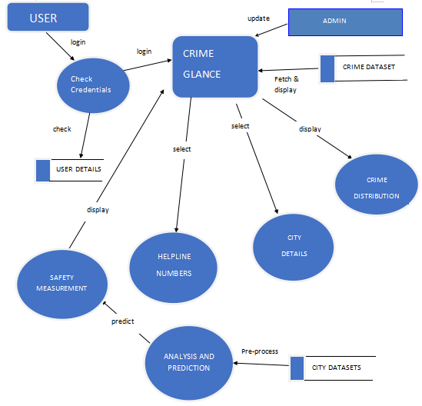
Data Flow Diagram - 1 Level

Slide 31
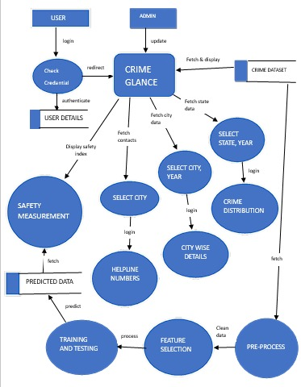
Data Flow Diagram - 2 Level

Slide 32
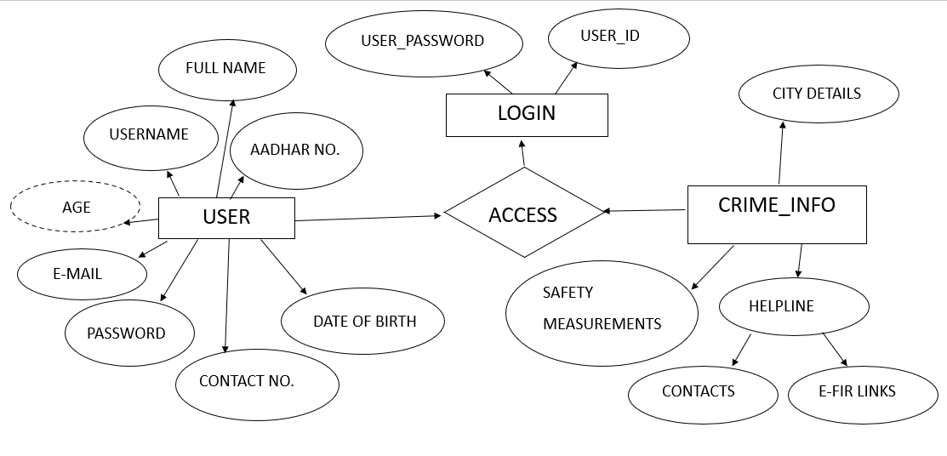
Entity-Relationship Diagram

Slide 33
Conclusions
In conclusion, our website for crime prediction is a useful resource for
comprehending and mitigating prospective criminal activity in a variety of contexts. We work to deliver precise insights and forecasts to improve public safety by utilising a large dataset, sophisticated algorithms, and machine learning techniques
In order to fully take advantage of the information offered by our website for crime prediction, we seek cooperation and active participation from law enforcement organisations, community stakeholders, and people.
We understand how crucial it is to consistently enhance our crime prediction models by incorporating the most recent data, enhancing algorithms, and taking user input into account. We work to create a future where crime rates arelower, people can live more independently, and technology can help

Slide 34
Future Scope
Adding a new feature of e-FIR, so that user don’t have to visit any other external site.
Adding new modules called police and one higher admin who mananges the working of each admins.
Continuous learning approach of algorithm will lead more better results in future.

Slide 35
References
https://uppolice.gov.in/
https://indianhelpline.com/
https://ncrb.gov.in/en/crime-in-india-table-addtional-table-and-chapter-contents
https://www.javatpoint.com
https://www.sciencegate.app/keyword/2759418
https://www.indiacensus.net
https://www.indiagrowing.com

Slide 36


